Slide 1
Whole Slide Image Stitching for Osteosarcoma detection
Ovidiu Daescu
Colaborators:
Bogdan Armaselu and Harish Babu Arunachalam
University of Texas at Dallas
John-Paul Bach, Kevin Cederberg, Dinesh Rakheja, Anita Sengupta, Stephen Skapek
and Patrick Leavey
UT Southwestern

Slide 2
Topics of presentation
Digital pathology
Whole Slide images (WSI)
Image Stitching for WSI
Image Stitching algorithms
Problem Statement
Architecture
The algorithm – Quad detection
Seamless image stitching
Results
Future work

Slide 3
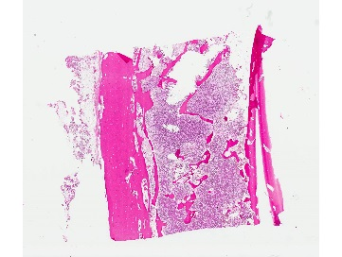
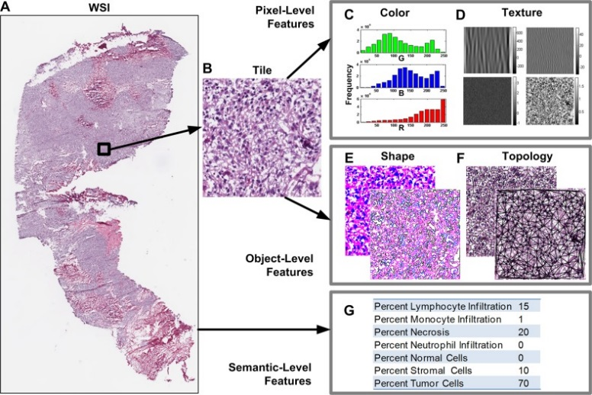
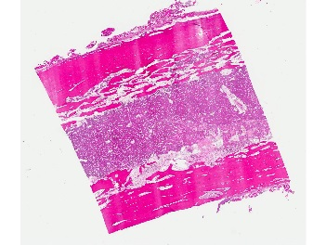
Digital Pathology
Digital pathology is the organization, management and analysis of pathology information through digital images
Images are large-resolution
Processing is computationally complex due to size of image
Image courtesy: Kothari S et al.

Slide 4
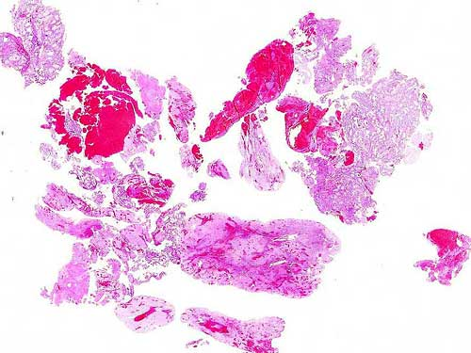
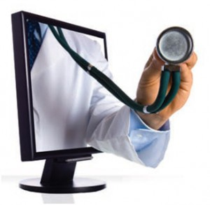
Whole Slide Images (WSI)
High magnification images of cells and tissues
Usually 20x or 40x times magnification
Each image is made of number of tiled images
There are very few open vendor image formats
Uses
Education, Research, Tele-pathology, Tele-consultation

Slide 5
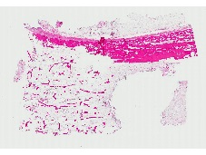
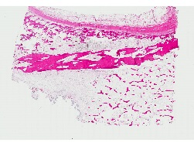
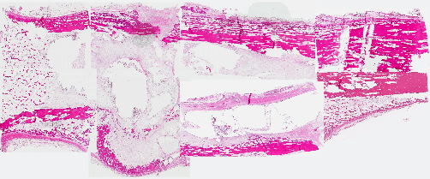
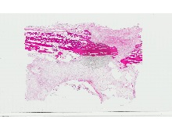
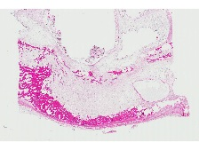
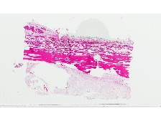
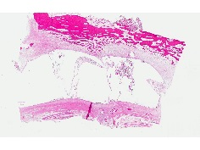
Image Stitching for WSI
Why is image stitching important ?
Helps in pathological image reconstruction
Gives a holistic view of slides under study
Helps to understand the bigger picture of the specimen
Helps to perform analysis on the gross image cumulatively.

Slide 6
Image stitching algorithms – till now
Require fixed dimensions of images
Use color gradients, average pixel methods for matching (Ma et al.)
Certain algorithms work with only fixed orientations (Gallagher et al.)
Template image and image slides have same color gradients
Very susceptible to noise in image slides

Slide 7
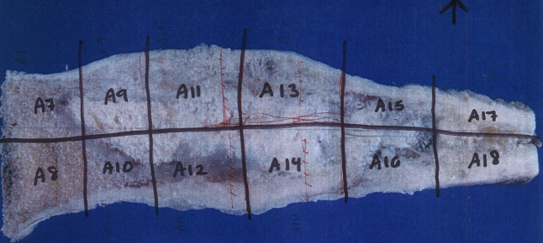
Problem Statement
Given: A template image of an unprocessed bone, a set of WSIs
To do: To reconstruct an image of WSIs using the template image
Helpful parameters: The images are JPEG, image names belong to a specific naming order
Typical Challenges
Template image and WSIs have different color gradients
Presence of artifacts
Orientation issues
Presence of noise in the form of inks, blurry images
Presence of large white margins
Dimensions of WSIs are not consistent

Slide 8
Architecture

Slide 9
The Algorithm
There are two phases for the algorithm
Quad generation <Input: gross image>
The gross image is run through Canny edge detector and grid lines are identified
The output image is then axis aligned using Hough transform and quads are generated
Seamless image stitching <Input: WSIs, Quad file >
The WSIs are then subjected to pairwise correlation using quads value
Stitching is performed based on pairwise gradient matching and canvas rendering through Coordinate maps

Slide 10
Quad generation (1/3)
Input: Gross image containing dark lines representing slicing boundaries
Output: Quad data file
The quads data are generated as follows
The gross image is run through Canny edge detector to generate the grid lines.
A Gaussian filter of (kernel width 5) is used to remove crooked/ skinny lines that are of less significance.
A color gradient of 60 is used to remove false positives and gray out colors less than threshold value

Slide 11
Quad generation– cont’d(2/3)…
This image is the input for the Hough transform, to estimate the angle of tilt of gross image with axis.
H( r, θ ) is the number of points on a line L( r, θ) such that ‘r’ is the length of the line L from the origin O
The most common angle of the lines in image is estimated as θ*
The gross image is rotated by an angle of θ* so that the image is axis aligned
Post processing Steps
Edge detection algorithms detect bone margins as edges and hence lines greater than threshold L = 2*sqrt(WxH) are selected.
Lines with distance greater than L/2 = sqrt(WxH) pixels are discarded to remove false positives.

Slide 12
Quad generation - cont’d (3/3)…
Computing quads
All the grid lines computed in previous step are sorted, horizontal lines by X coordinates and vertical lines by Y-coordinates.
An intersection of the horizontal and vertical lines yield bounding boxes of X,Y, Width, Height
They are then written into a quad file as <WSI name, X, Y, width, height>
The WSIs are numbered in lexicographical order from left to right and their position in gross images are computed in non-decreasing order

Slide 13
Seamless Image Stitching
Input: WSI files and Quad data file
Output: Seamlessly stitched final image
The image stitching is performed as follows
Image rotation based on pairwise correlation
Seamless image stitching based on pairwise gradient matching
Image rendering through coordinate mapping and transformation point

Slide 14
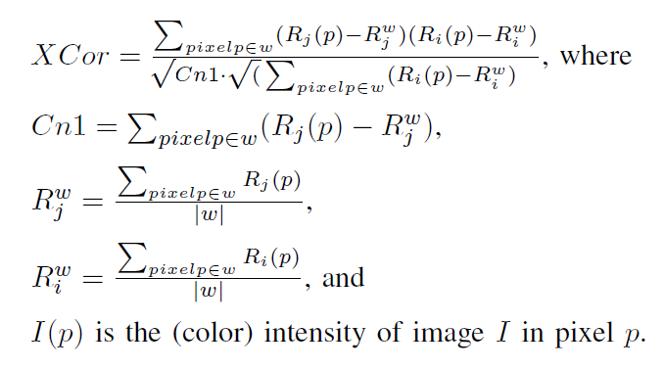
Seamless image stitching
Image rotation based on pairwise correlation
Two images Ri and Rj are rotated to find the best match.
The following pairwise calculation is used on each pixel of Ri and Rj within window ‘w’

Slide 15
Seamless image stitching – cont’d (2/3)
For each of the WSIs in the dataset, the best pairwise gradient Gi and Gj is found
The best matching index for each row is computed for each row and each column
Image rendering through coordinate mapping and transformation point
Based on the quads data, a coordinate map is populated
Each image is rendered by iterating the coordinate map

Slide 16
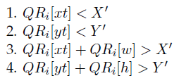
Seamless image stitching – cont’d (3/3)
The images might suffer from noise and blurred regions which might affect image stitching.
In case the gradient calculation is same for two images, the image orientation might be wrong
Such incorrect image rendering is corrected manually by calculating transformation points from quad record, QR
Coordinates are calculated based on the following condition
The transformation point of rotation is retrieved as follows

Slide 17
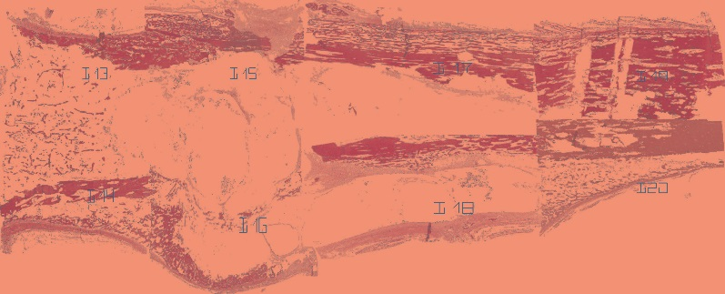
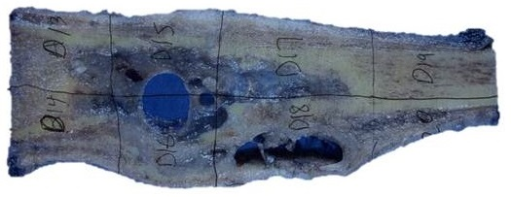
Some results
All data were JPEG images, taken from UTSW Osteosarcoma patient database. All images are from positive cancer samples.
We have 98% accuracy on the datasets we used.
Results are as follows
O/P
Seamless stitching in Java application
Gross image
WSIs
Seamless stitching in HTML/JS application

Slide 18
Future work
Extend the application for SVS and Big-Tiff images
Perform image analysis on SVS images.
pixel-based, object-based and semantics-based segmentations
Build knowledge base and learn Cancer Regions of Interest(ROIs) using Machine Learning techniques: predictive modelling, clustering
Build a sliding window application for selective analysis

Slide 19
Thank you!
Questions welcome ☺

