Slide 1
Largest Red-Blue Separating Rectangles
Bogdan Armaselu, Ovidiu Daescu, Chenglin Fan and Benjamin Raichel
University of Texas at Dallas

Slide 2
Largest Red-Blue Separating Rectangle
Original problem
Given:
n red points R
m blue points B
Goal: find largest area axis-aligned B-empty rectangle that contains R (called largest red-blue separating rectangle)

Slide 3
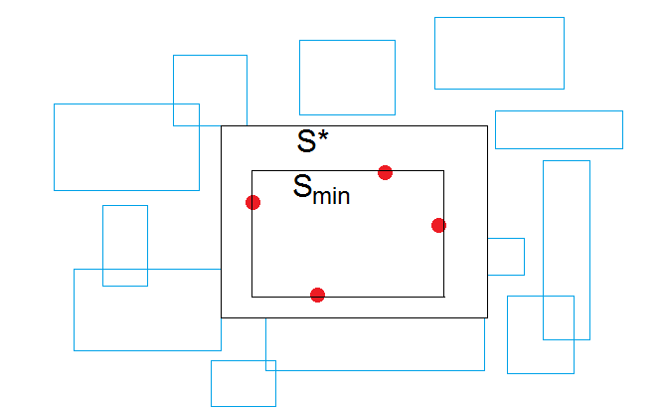
Our contributions
We consider extensions of the original problem
Blue Rectangles problem
Given n red points R and m AA (possibly intersecting) rectangles B
Goal is to find largest area rectangle containing all red points and not intersecting any AA rectangle
O(m log m + n) time

Slide 4
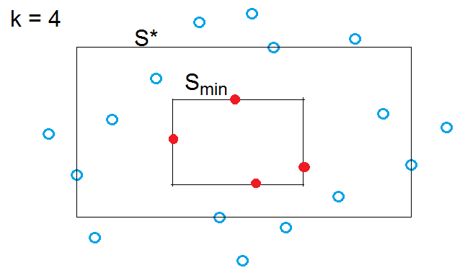
Our contributions
Outliers Problem
Given n red points R and m blue points B and an integer k
Goal is to find the largest area rectangle enclosing R and containing <= k blue points (“outliers”)
O(poly(k) m log m + n) time

Slide 5
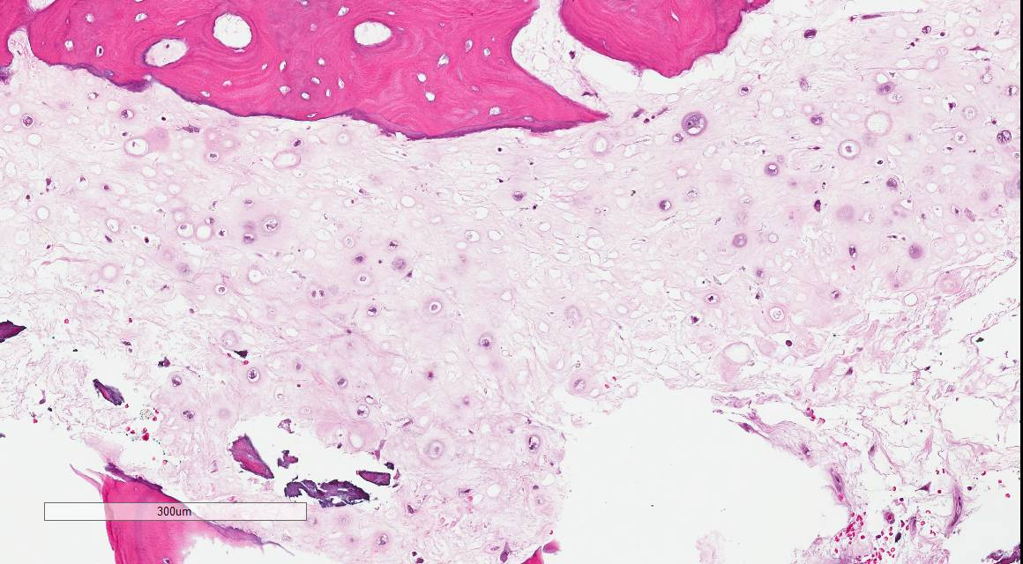
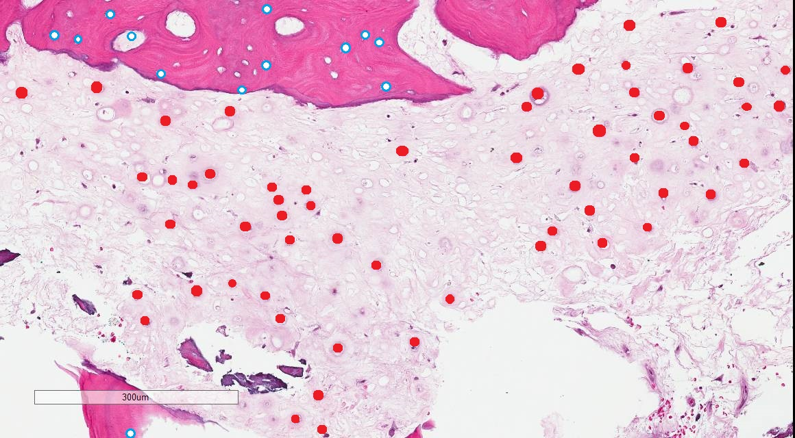
Motivation
Tumor separation
Want to separate tumor from non-tumor in a given radiological H&E-stained image
Red points denote tumor cells, blue points (and rectangles) denote healthy cells and surrounding tissue

Slide 6
Related work
Nandy et al (1990) [4]
Find all maximal empty rectangles (MER) among axis-aligned non-intersecting rectangles
O(n log n + r) time, where r is the number of MERs
Nandy et al (1994) [3]
Find one largest empty rectangle among arbitrary non-intersecting obstacles (such as sticks and polygons)
O(n log² n) time
Also show how to find empty rectangle inside polygon

Slide 7
Related Work
Sharir et al (2012) [2]
Find largest empty rectangle among a point set P that contains only a query point q
O(n log⁴ n) time pre-processing
O(log⁴ n) time query
Given q and set B, finds max area rectangle in O(m log m) time
Given q and staircase for B, finds max area rectangle in O(m α(m)) time

Slide 8
Original Problem
Find largest B-empty rectangle enclosing R
The lines defining S_{min} divide the plane into 9 regions: S_{min}, E, NE, N, NW, W, SW, S, and SE
For each such region r, let B_{r} denote the set of blue points located in r
Extend S_{min} in each direction until it touches a blue point in each of E, N, W and S
Denote by S_{max} the resulting rectangle
NW
N
NE
S_{min}
W
E
SW
S
SE

Slide 9
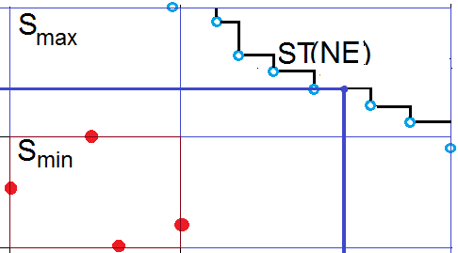
Original Problem
Definition. For p, q ϵ NE, p dominates q if x(p) > x(q), y(p) > y(q)
The definition can be applied to other quadrants by swapping inequalities
A rectangle enclosing R is B_{NE} -empty if its NE corner does not dominate any points from B_{NE}
The staircase ST(NE) of B_{NE}: the NE boundary of region not dominating any blue point in B_{NE}
The largest red-blue separating rectangle is the largest rectangle containing S_{min} and not containing any point of any of the four staircases

Slide 10
Original → Staircase
The original problem reduces to the Staircase Problem, stated as follows.
Given AA rectangles S_{min}, S_{max}, with S_{min} contained in S_{max}, and a staircase for each quadrant defined by S_{min}
Goal is to find the largest area rectangle S* containing S_{min} and not containing any point of any staircase.
We solve Staircase Problem in O(t) time, where t is the complexity of the staircase
Removed α(t) factor
Since t = O(m) and computing ST() takes O(m log m) time, we solve Original Problem in O(m log m + n) time

Slide 11
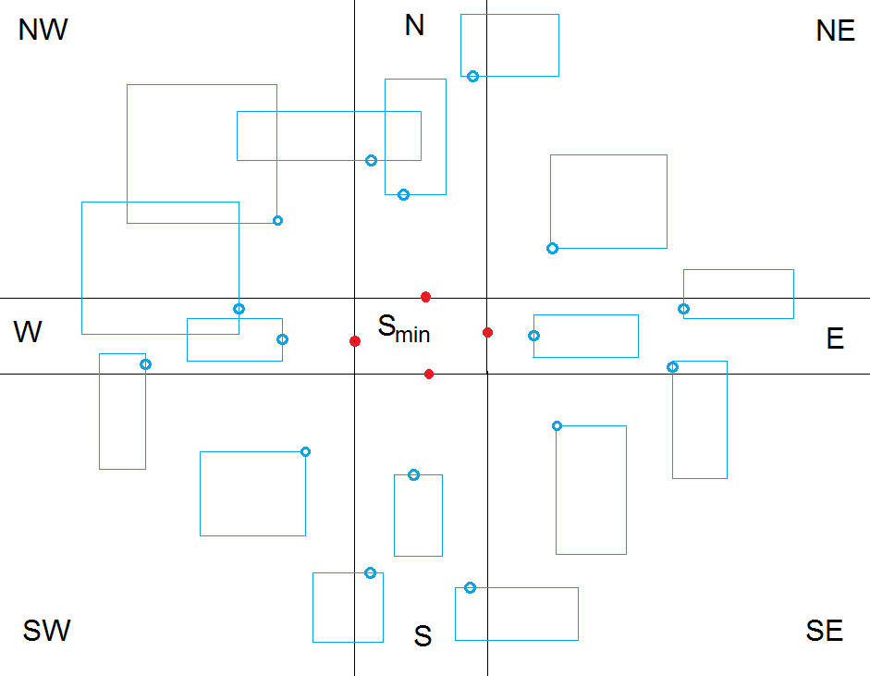
Blue Rectangle Problem
Want largest rectangle enclosing R while avoiding AA rectangles in B
Blue Rectangle → Original
For side regions, e.g. E, for each rectangle r intersecting E:
consider an arbitrary point p ϵ E on the left side of r
note that a rectangle enclosing S_{min} intersects r iff it contains p
For corner regions, e.g. NE, for each rectangle r crossing NE:
consider corner q of r, such that q ϵ NE and q does not dominate any point of r
note that a rectangle enclosing S_{min} intersects r iff its NE corner p dominates q
Let B’ be the resulting “blue” point set
Solve Original Problem on R and B’

Slide 12
Outliers Problem
Want largest rectangle containing R and <= k blue points
There are O(k⁷) ways to partition k into integers k_{E}, …, k_{SE} s.t. k_{E} + … + k_{SE} = k
For each such partition, we find the largest rectangle that encloses S_{min} and contains k_{E} points from E, k_{NE} from NE, etc.
From each side region, e.g. E, we take the (k_{E} +1)-th leftmost point in B_{E}

Slide 13
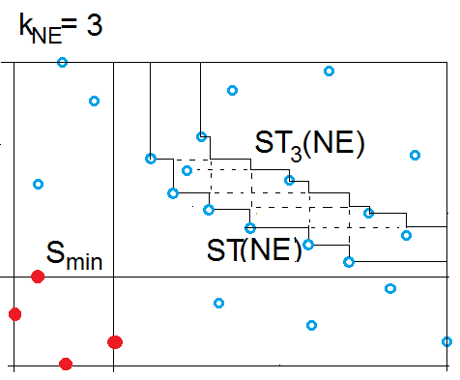
Outliers Problem
Denote by ST_{k}(P) the k-th level staircase of P, i.e. chain of points dominating exactly k points in P
From each corner region, e.g. NE, we find ST_{k}(B_{NE})

Slide 14
Outliers Problem
Lemma 1. For any set P of m points and any integer k, there exists a set Q of O(m) points such that ST_{k}(P) = ST(Q). Moreover, ST_{k}(P) can be computed in O(m log m) time
Proof (sketch).
- There are two types of points that can be in Q
Points p in P that dominate k points in P
Points q not in P but with either the same X coordinate or the same Y coordinate as some point r in P (“breakpoints”) s.t. q dominates k points in P
- Thus, the points in ST(Q) dominate exactly k points in P, i.e. ST(Q) = ST_{k}(P)

Slide 15
Outliers Problem
O(m) points in P dominate k other points in P
In a staircase, for each X coordinate of a point, there is at most one breakpoint
Hence O(m) breakpoints, so |Q| = O(m)
To compute ST_{k}(P), sweep a vertical line from S_{min} to the right
Maintain the points in P seen so far, along with # points they dominate, in a balanced BST sorted by Y

Slide 16
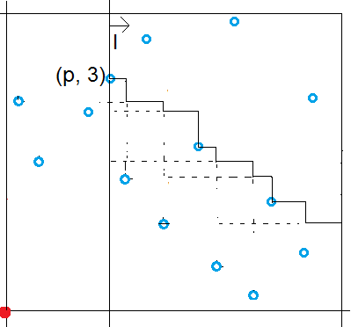
Outliers Problem
Each point p in P induces an “event” on ST_{k}(P)
Based on Y(p) and the contents of BST, can determine the number t of points that p dominates in O(log m) time
If t = k, then add p to ST_{k}(P)

Slide 17
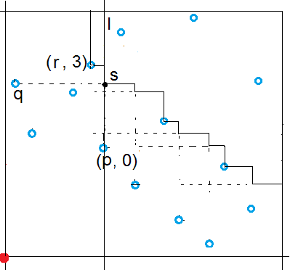
Outliers Problem
Else, if there exist points q, r s.t. r is on ST(P) and q is highest below r to the left of l, then s is a breakpoint, where X(s) = X(p), Y(s) = Y(q)
q, r and s can be found in O(log m) time
There are O(m) events and we spend O(log m) for each, so O(m log m) in total
To solve the k-Outlier Problem for a given quadrant, find the k-th level staircase of the quadrant, then solve the Staircase Problem

Slide 18
Conclusion
Theorem 2. Blue Rectangle Problem can be solved in time O(m log m + n) and space O(m + n)
Theorem 3. Outliers Problem can be solved in time O(m log m + n) with O(m + n) space for a given partition k_{E} + … + k_{SE} = k
Reduction to Staircase Problem
This gives O(k⁷ m log m + n) overall

Slide 19
Open problems
Faster approach for the outlier case (want to avoid treating all possible partitions of k, thus avoiding the O(k^7) factor)
Replace AA rectangles in B with other shapes (circles, polygons, etc)
Find largest arbitrary oriented rectangle among different shapes
Largest circle among different shapes

Slide 20
References
[1] B. Armaselu and O. Daescu. Maximum Area Rectangle Separating Red and Blue Points. CCCG’2016: 244-251
[2] H. Kaplan, S. Mozes, Y. Nussbaum, and M. Sharir. Submatrix maximum queries in monge matrices and monge partial matrices, and their applications. 23rd Annual ACM-SIAM Symposium on Discrete Algorithms: 338-355, 2012.
[3] S.C Nandy, A. Sinha, and B.B. Bhattacharya. Location of the largest empty rectangle among arbitrary obstacles. Foundations of Software Technology and Theoretical Computer Science: 159-170, 1994.
[4] S. C Nandy, B. B. Bhattacharya and S. Ray. Efficient algorithms for identifying all maximal isothetic empty rectangles in VLSI layout design. FSTTCS 1990: 255-269

